Slide 1
Database Design Concepts
Er. Gautam K. Gupta
Bachelor of Engineering in Computer Science.
Software Developer at e-Zone international Pvt. Ltd.
Email: thegautamgupta1990@gmaill.com
WebSite:gautamgupta.com.np

Slide 2
Objective of this course
To give learners opportunities to develop an understanding of the concepts and issues relating to databases and database design as well as the practical skills to translate that understanding into
the design and creation of complex databases.

Slide 3
References
Abraham Silberchatz, Henry F. Korth, S. Sudarshan; Database System Concepts. McGraw Hill, 4th edition
Date C. J.; An Introduction to Database System. Addison Wesley, 8th edition

Slide 4
Basic Concept
At a Conference in 1990, Silberschatz quoted on database systems- “ The history of database system research is one of exceptional productivity and starting economic impact.
Barely 20 years old as a basic science research field, database research has fueled an information service industry estimated at $10 billion per year in U.S. alone.
Achievements in database research underpin fundamental advances in the communication system, transportation and logistics, financial management, knowledge based systems (KBS), accessibility to scientific literature and a host of other civilian and defense application.
The roots of DBMS lie in file-based systems.

Slide 5
Three generations of DBMS
1st Generation : The hierarchical and CODASYL systems represent the first generation of DBMS. The hierarchical model is typified by IMS (Information Management System) and the Network or CODASYL model by IDS (Integrated Data Store). Both of these models were developed in mid-1960s.
2nd Generation : In 1970, Dr. E.F. Codd represented a research paper at an international conference where he proposed a relational model. It represents the second generation of DBMS.
3rd Generation : It is represented by the Object-Relational DBMS and the Object-Oriented DBMS.

Slide 6
Introduction
A database is the solution to store, reference and view the information in various forms.
It provides various tools and objects to view the information stored as tables.
It provides more efficient way to manage the information compared to an ordinary files system.
DBMS provides organization, with the capability to easily integrate and leverage the massive amounts of operational data into meaningful information.
Database technology has been described as one of the most rapidly growing areas of computer business and information of science.
Defining a database involves specifying the data types, structures and constraints for the data to stored in the database.
The DBMS is a general purpose software system that facilitates the processes of defining, constructing and manipulating database for various application.

Slide 7
What is Data?
Effective data management enables raw data to become useful information. Thus, information helps us to foresee and plan events.
The data are always termed as the raw materials for information. A meaningful information is only possible after processing such a raw data.
Data must be atomic. The atomic data cannot be broken into pieces.
ANSI definition, Data is defined as follows: “ Data is a representation of facts, concept or instructions in a formalized manner suitable for communication, interoperation, or processing by humans or by automatic means.”

Slide 8
What is Information?
It is defined as a collection of related data that when put together, communicate meaningful and useful message to recipient who uses it, to make decision or to interpret the data to get the meaning.
Actually, it is data that has been converted into a more useful or intelligible form.
For example, marks obtained by students and their roll numbers form data where their marksheet is the information.
Data
When
processed
Information
When
processed
Knowledge

Slide 9
Role of Data in Business
In the world of business, predicting an event and planning for it could save money and time for an organization.
Let’s consider an example, A company manufacturing high quality food grade plastic containers is planning its annual purchase of a certain raw material. With data on the sales of these containers for the last 10 years, the company heads can find out the percentage increase in the consumption of the product. Let’s assume they find a percentage increase in the range of 22 to 30% annually. Based on their findings, a production plan can be prepared, which will cater to a production increase of 30%.
Thereby the company will now place an order only for that much quantity of raw material, thus sawing precious foreign exchange, warehouse space and other related resources.

Slide 10
Features of DataBase
The data in a database should have the following features:
Shared: Data in a database is shared among different uses and applications.
Persistence: Data in a database exists permanently.
Validity: Data should be correct with respect to the real world entity that they represent.
Security: Data should be protected from unauthorized access.
Consistency: Whenever more then one data element in a database represents related real world values should be consistent with respect to the relationship.
Non-redundancy: No two data items in a database should represent the same real world entity.
Independence: Data should be abstract i.e. it should be independent of each other at different levels. Changes at one level should not affect the other level

Slide 11
File Processing System
Before the development of the DBMS, file processing system is used. The actual reason for the introduction of DBMS is various flaws in the conventional file processing system.
A file is a collection of data about a single entity i.e. files are collection of similar records. Files are typically designed to meet needs of a particular department or user group. Files are also typically designed to be part of a particular computer application.
Data storages is build around the corresponding application that uses the files.
The typical file processing system is supported by a conventional operating system. In file processing system, permanent records are stored in various files, and a number of application programs are written to extract records form and add records to the appropriate files.
Users of file processing systems are almost always at the mercy of the Information Systems department to write programs that manipulate stored data and produce needed information such as printed reports and screen displays.

Slide 12
Disadvantage File Processing System
File Processing System has a number of disadvantages, they are:
Data redundancy and Inconsistency
Data redundancy means repetition of same data in the database.
Data Inconsistency means not a similar data in database for a particular time.
In conventional data systems, an organization often builds a collection of application programs often created by different programmers and requiring different components of the operational data of the organization.
The data in conventional data systems is often not centralized.
Some applications may require data to be combined from several systems.
These several system could well have data that is redundant as well as inconsistent; i.e. different copies of the same data may have different values.
File
Information System
Information System
File
File
Information System
Database
Information System
File
Information System

Slide 13
Disadvantage File Processing System
2. Difficulty in Accessing Data
Suppose the bank officers need to find the names of all customer who live in Lalitpur, Patan. The officer asks the data processing departments to generate such a list. Since there is no such program to fulfill the needs, hence officer has two choices either get the list of customers and get required information manually or write the application program. Hence there is difficulty in accessing data.
3. Data isolation
Since data is scattered in various field may be in different formats, it is difficult to write new application programs to retrieve the appropriate data.
4. Security Problem
Not every user of the database system should be able to access all the data.
5. Integrity Problems
The data values stored in the data must satisfy certain type of consistency constraints. For example, the balance of the bank account may never fall below the prescribed amount (say Rs. 500.00). These constraints are reinforced in system by adding appropriate code in various application.

Slide 14
Database Management System (DBMS)
A DATABASE SYSTEM, also known as a Database Management System (DBMS), are large complex pieces of software designed specifically for the efficient management of data.
i.e. It is a software system that provides facilities for storing and retrieving data quickly and in a format that matches user needs.
Examples:
Oracle (Oracle Corporation)
Ingres (Computer Associates)
SQL Server (Microsoft Corporation)
Access ( Microsoft Corporation)
IMS, DB2 (IBM)
And many more…

Slide 15
Database Management System (DBMS) contd ………
Databases system typically store data on a persistent or non-volatile medium such as a disk which does not lose the data when the power is shut off.
Databases are used everywhere including in corporations, ecommerce, telecommunications, government agencies, pharmaceutical research, universities, and personal applications.
Database systems are the underpinning of the information society. Without them, it would be difficult to conduct just about any business activity, especially those involving large amounts of data.

Slide 16
Database system Provide
persistent storage
data definition
Data manipulation (queries for reading, updating, inserting, ad data deleting)
allow multiple users to simultaneously access the database without interference
fast access (via indexes)
alerts
data consistency maintenance
data security (preventing unauthorized users from accessing data)
bulk loading (fast loading of large amounts of data)
backup and
recovery from software and hardware crashes, and from media failure.

Slide 17
Database Applications
Banking: all transactions
Airlines: reservations, schedules
Universities: registration, grades
Sales: customers, products, purchases
Manufacturing: production, inventory, orders, supply chain
Human resources: employee records, salaries, tax deductions
Databases touch all aspects of our lives

Slide 18
Purpose of Database System
In the early days, database applications were built on top of file systems
Drawbacks of using file systems to store data:
Data redundancy and inconsistency
Multiple file formats, duplication of information in different files
Difficulty in accessing data
Need to write a new program to carry out each new task
Data isolation — multiple files and formats
Integrity problems
Integrity constraints (e.g. account balance > 0) become part of program code
Hard to add new constraints or change existing ones

Slide 19
Brief History of DBMS
Pre-1960s
Data was stored in files.
Each file was described in the program code of every program that used it.
Each application system was, in effect, a special-purpose Data Base Management System.
Emergence of the “database” concept
In the early 1960s, the term “database” began to be applied to the integrated collection of files each organization, or section within an organization, needed to maintain.
There was a need perceived for general-purpose “Database Management Systems” to be supplied by software vendors to enable data bases to be built and used effectively.

Slide 20
Advantages of Database Processing
Extracting Information from Data
Sharing of Data
Standards
Controlled Redundancy
Integrity Control
Security
Economy of Scale
Data Independence

Slide 21
Function of DBMS
The functions performed by a typical DBMS are the following:
Data Definition
The DBMS provides functions to define the structure of the data in the application. These include defining and modifying the record structure, the type and size of fields and the various constraints/conditions to be satisfied by the data in each field.
Data Manipulation
Data Security and Integrity
Data recovery and Concurrency
Data Dictionary Maintenance
Performance

Slide 22
Levels of Abstraction
For the system to be usable, it must be retrieve data efficiently. The need for efficiency has led to designers to use complex data structures to represent data in the database. Since many database systems users are not computer trained, developers hide the complexity from the users through several levels of abstraction, to simply users interactions with the system:
Physical level
Logical level
View level

Slide 23
Schema and Instances
Schema
Overall design of the database is called the database schema.
Database schemas have various schemas, partitioned according to the levels of data abstraction that we discussed.
Three level of schema
External Schema
Conceptual Schema
Internal Schema
Instances
The collection of information stored in the database at a particular moment is called an instance of the database.
Analogous to the value of a variable

Slide 24
Database Languages
A database system provides a data definition language to specify the database schema and a data manipulation language to express queries and updates.
In practice , the DDL and DML are not two separate languages; instead they simply form parts of a single database language, such as the widely used SQL language.

Slide 25
Data Definition Language (DDL)
Specification notation for defining the database schema
E.g. create table account ( account-number char(10), balance integer)
DDL compiler generates a set of tables stored in a data dictionary
Data dictionary contains metadata (i.e., data about data)
database schema
Data storage and definition language
language in which the storage structure and access methods used by the database system are specified
Usually an extension of the data definition language

Slide 26
Data Manipulation Language (DML)
Language for accessing and manipulating the data organized by the appropriate data model
DML also known as query language
Two classes of languages
Procedural – user specifies what data is required and how to get those data
Nonprocedural – user specifies what data is required without specifying how to get those data
SQL is the most widely used query language

Slide 27
SQL
SQL: widely used non-procedural language
E.g. find the name of the customer with customer-id 192-83-7465 select customer.customer-name from customer where customer.customer-id = ‘192-83-7465’
E.g. find the balances of all accounts held by the customer with customer-id 192-83-7465 select account.balance from depositor, account where depositor.customer-id = ‘192-83-7465’ and depositor.account-number = account.account-number
Application programs generally access databases through one of
Language extensions to allow embedded SQL
Application program interface (e.g. ODBC/JDBC) which allow SQL queries to be sent to a database

Slide 28
Database Administrator (DBA) Responsibilities
The responsibility of a database administrator vary and depend on the job description, corporate and Information Technology (IT) policies and the technical features and capabilities of the DBMS being administrated.
Database administrator's duties include:
Schema definition
Storage structure and access method definition
Schema and physical organization modification
Granting user authority to access the database
Specifying integrity constraints
Acting as liaison with users
Monitoring performance and responding to changes in requirements

Slide 29
DBMS Components
Database engine
Storage
Retrieval
Update
Query processor: The query processor subsystem compiles and executes DDL and DML statements.
Data dictionary: The data dictionary contains METADATA. The schema of a table is an example of metadata.
Utilities
Security
Report writer
Forms generator(input screens)
Application generator
Communications

Slide 30
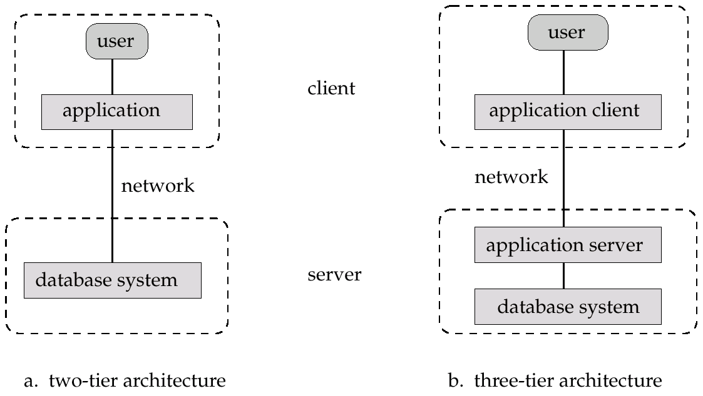
Application Architecture
Most user of a database system today are not present at the sit of the database system, but connect it through network. We can therefore differentiate between client machines, on which remote database user works, and server machines, on which the database system runs
Two-tier architecture: E.g. client programs using ODBC/JDBC to communicate with a database
Three-tier architecture: E.g. web-based applications, and applications built using “middleware”

Slide 31
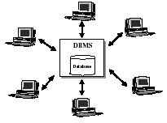
Centralized Database system

Slide 32
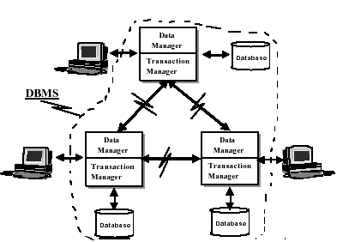
Distributed Database System

Slide 33
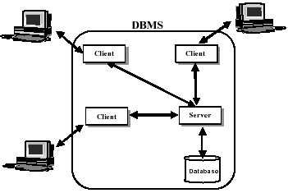
Client/Server Architecture

